Slide 1
2 Stage-UNET For Pneumothorax Segmentation :
Final Eval
Krishna Kumar Maram (2018122003)

Slide 2
Problem Statement
Given a chest X-Ray, we want to build an image processing pipeline that can automatically detect and segment out the regions of the X-Ray that are affected by Pneumothorax (collapsed lung). We will be using a 2 stage UNET for segmenting the X-Rays. This process of identifying the affected regions is primarily done manually by trained radiologists as of now, but such image processing pipelines can make the entire process much faster and economical for the patients and thus help in early diagnosis and saving precious lives of the patients.

Slide 3
Objectives
Segmentation of X-Rays to find Pneumothorax affected regions.
Perform Two Stage training on the chest X-ray training dataset from the SIIM-ACR Pneumothorax Segmentation Challenge.
Testing the trained model on the test dataset and compare different pipelines to find the optimal segmentation pipeline.
Document and report our findings and compare them with that of the reference paper.

Slide 4
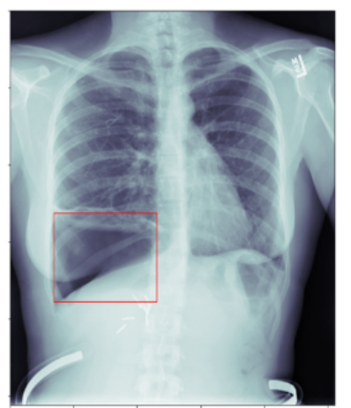
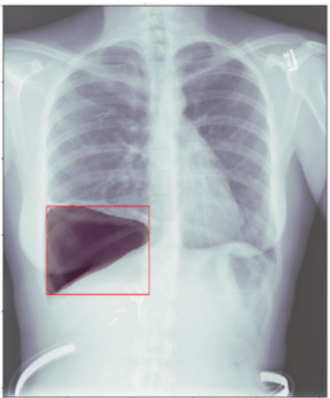
Objectives
Image Processing Pipeline
Input X-Ray
Segmented Output

Slide 5
Dataset
Chest X-ray dataset from the SIIM-ACR Pneumothorax Segmentation Challenge.
Collected using the Cloud Healthcare API.
Uses the Digital Imaging and Communications in Medicine (DICOM) format for encoding the metadata along with the X-Ray image in a single file.
Training dataset has the X-Ray and annotations in the form of masks specifying the region affected by pneumothorax.
10,065 training and 1,830 testing images.

Slide 6
Method Overview
The entire project timeline can be broken down into 3 phases:
Data Processing and Augmentation : where we modify the given dataset to create more robust and diversified training data.
Training the UNET model
Testing the UNET model.

Slide 7
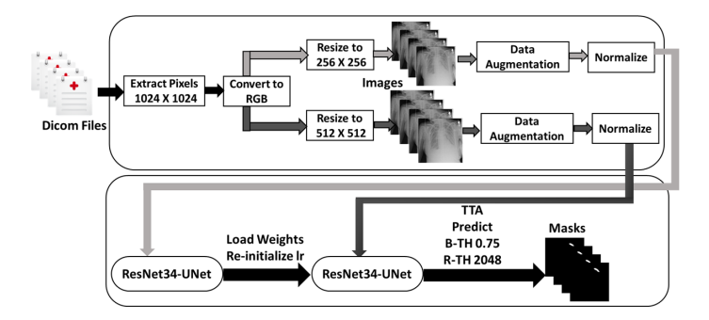
Method Overview

Slide 8
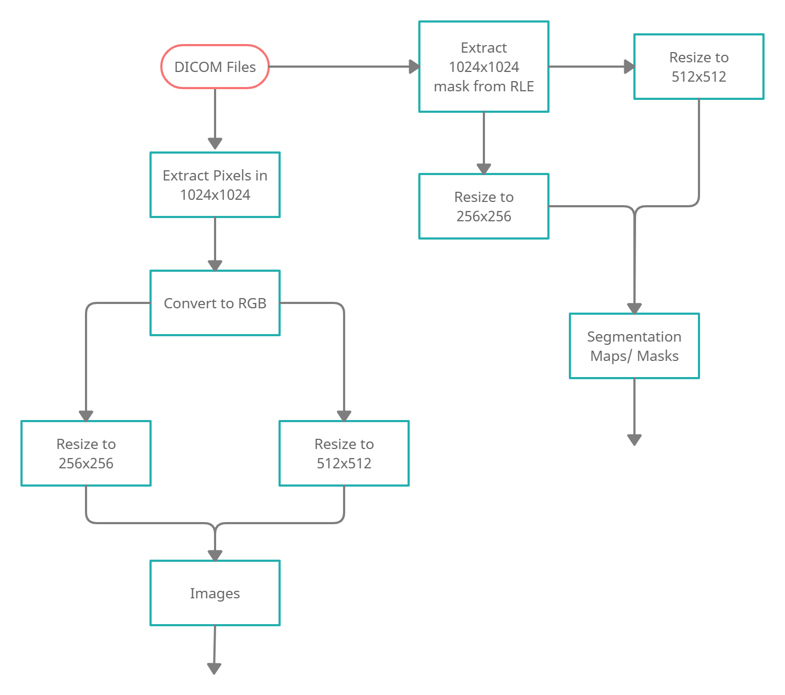
Method Overview (Data Preprocessing and Augmentation)

Slide 9
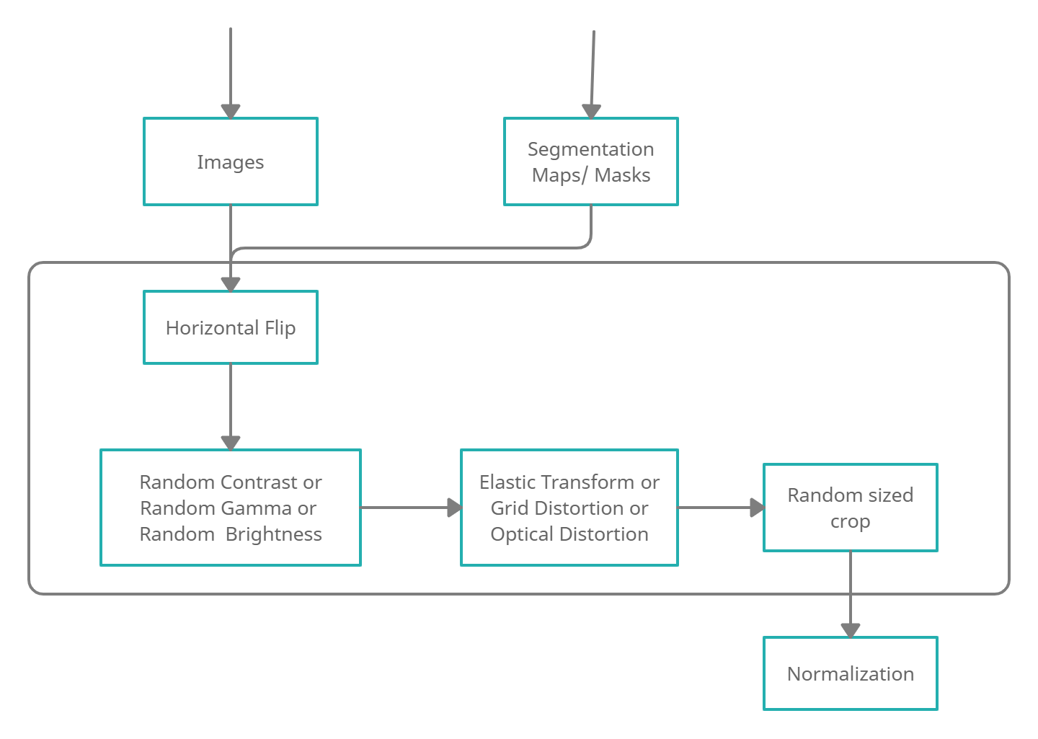
Method Overview (Data Preprocessing and Augmentation)
Data Augmentation and Normalization that helps in generalization of error.
After Normalization, both pixel intensity values and mask values are mapped to 0 or 1 instead of 0 or 255.
Data Augmentation Groups

Slide 10
Method Overview (Training Phase)
U-Net as a segmentation model.
Transfer Learning with ResNet-34 pre-trained on ImageNet dataset as the backbone.
2 stage training.
1st stage : Train the model on lower resolution (256x256) images as obtained from Data Processing phase.
2nd stage: Reinitialise the learning rate and further train the model from the 1st stage on higher resolution images (512x512).

Slide 11
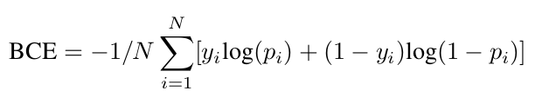


Method Overview (Training Phase)
Combination of Binary Cross Entropy(BCE) and Dice Loss(DSCL) for the Loss function. N = no. of samples, y = ground truth, p = predicted value X = predicted set of pixels, Y = ground truth Loss function is given by:

Slide 12
Method Overview (Training Phase)
Test out 5 different training pipelines to optimise the model:
To train the network of grayscale images with pre-trained weights, 1-channel data has to be mapped to 3-channels. Adam optimizer and ReduceLROnPlateau9 scheduler are going to reduce the learning rate by a factor of 0.2 if no improvement is seen for 5 patience based on the validation loss. The Binarization Threshold (B-TH) is 0.5 for the prediction.
Segmentation network on the 256 × 256 resolution images with 3-channels for 35 epochs with 40 batch size is going to be trained. Moreover, the B-TH is 0.55 for the prediction.
The weights from the above model (pt. 2) is going to be loaded and the learning rate is going to be reinitialized. Then, we train the network on the 512 × 512 resolution images with 3-channels for 10 epochs with batch size 14. The B-TH is 0.55 for the prediction.

Slide 13
Method Overview (Training Phase)
4. Train on 256 × 256 resolution images, and 3-channels for 60 epochs with batch size 40 is trained. Then, the weights are going to be loaded and the learning rate is going to be reinitialized to retrain the network on the 512 × 512 resolution images and 3-channels for 29 epochs with batch size 14.
5. Train on 256 × 256 resolution images, and 3-channels for 100 epochs with batch size 40 is trained. Then, the weights are going to be loaded and the learning rate is going to be reinitialized to retrain the network on the 512 × 512 resolution images and 3-channels for 70 epochs with batch size 14.

Slide 14
Method Overview (Testing Phase)
Around 2k images were considered. The images were resized to 512×512, and converted to RGB colors with normalization.
Image post processing - Apply horizontal flip, Test time augmentation to test images.
Use the Removal Threshold (R-TH) for each predicted mask to reduce false positives. The components that are less than the minimum size of pixels are removed.
The final prediction is the average prediction for all images.

Slide 15
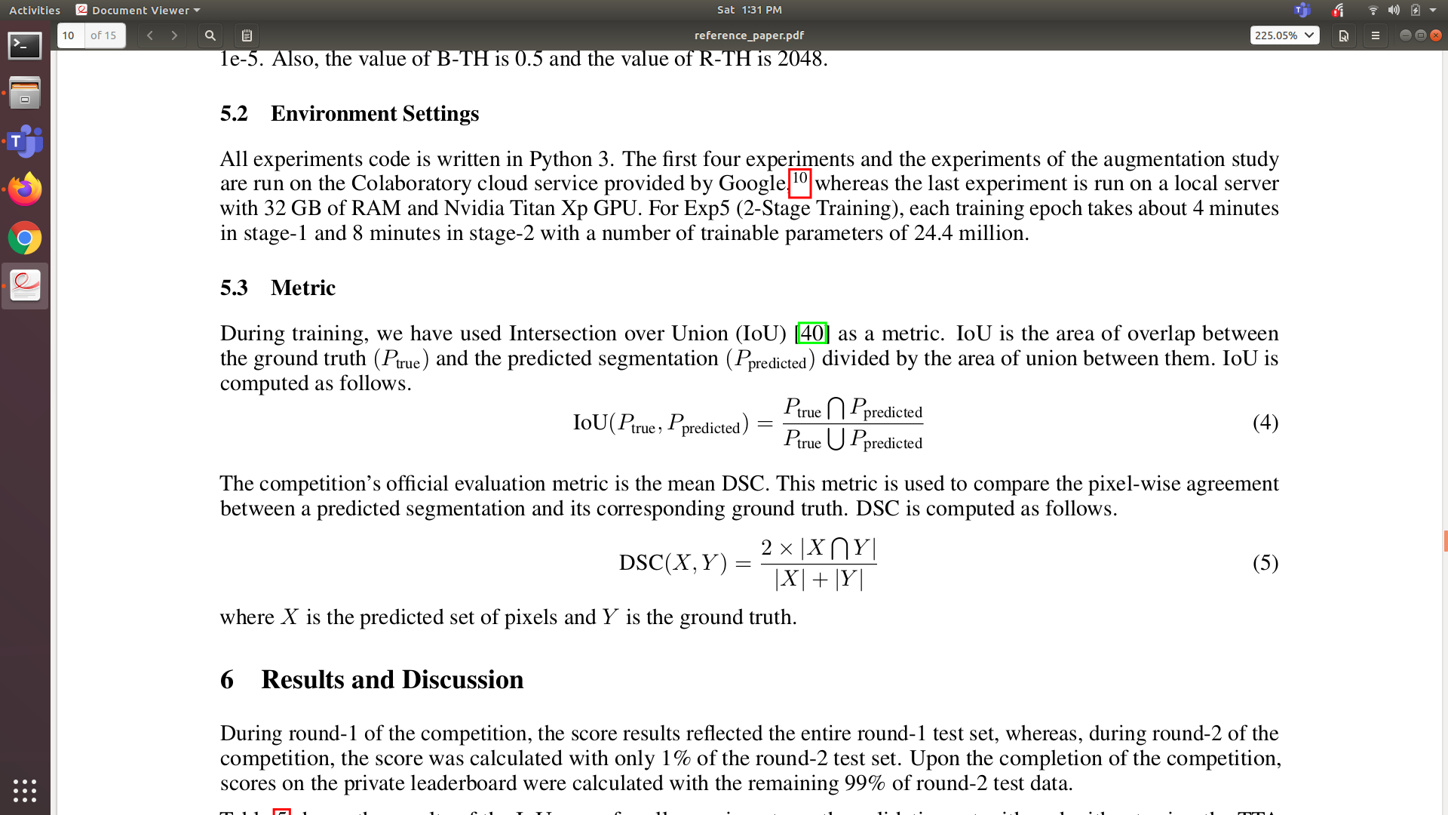
Method Overview (Testing Phase)
IOU Score - Area of overlap between Ground truth and Predicted segmentation divided by union of between them.
DSC Score - Pixel-wise agreement between a predicted segmentation and its corresponding ground truth. DSC is computed as follows. X - Predicted set of pixels, Y- Ground truth set of Pixels. Calculated Mean DSC score.

Slide 16
Method Overview (Testing Phase)
Performed TTA and Horizontal flip, random contrast, random and random brightness and random sized crop, together along with R-TH and B-TH.
Test-time augmentation is the application of data augmentation techniques normally used during training when making predictions.
Specifically, it involves creating multiple augmented copies of each image in the test set, having the model make a prediction for each, then returning an ensemble of those predictions.
Testing was done on 2k images in batches of size 5. And IOU and DSC scores were calculated.

Slide 17
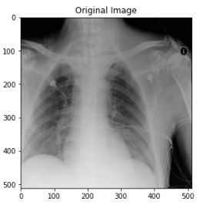
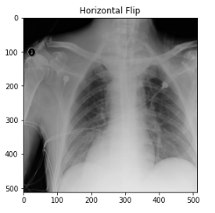
Results
Data Preprocessing and Augmentation

Slide 18
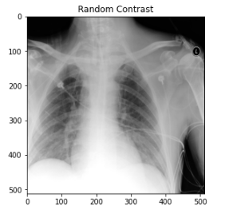
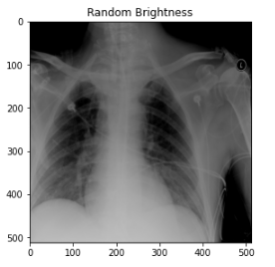
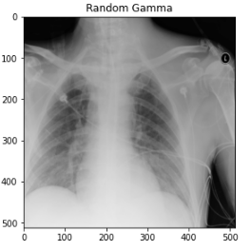
Results
Data Preprocessing and Augmentation

Slide 19
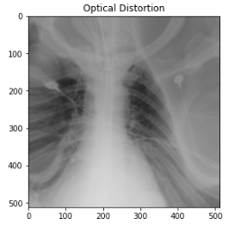
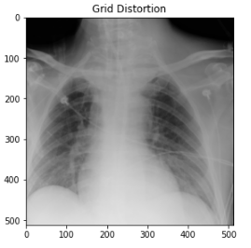
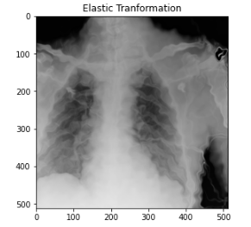
Results
Data Preprocessing and Augmentation

Slide 20
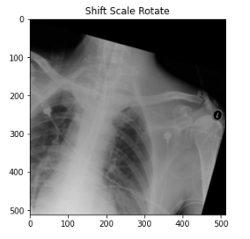
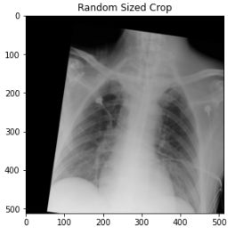
Results
Data Preprocessing and Augmentation

Slide 21
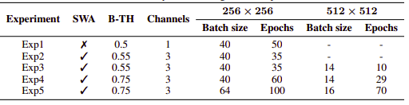
Results
Training Phase

Slide 22
Results
Stage-1 Training IoU Scores
Exp No. | From the Study | From our experiments
Exp1 | 0.7242 | 0.7149
Exp2 | 0.7349 | 0.7223
Exp3 | 0.7105 | 0.7023
Exp4 | 0.7422 | 0.7366
Exp5 | 0.7638 | 0.7531

Slide 23
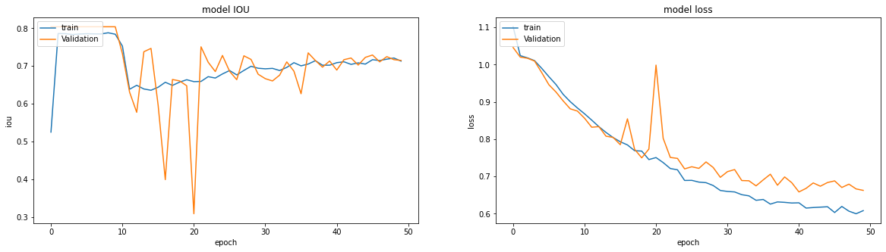
Results Stage-1 Experiment-1

Slide 24
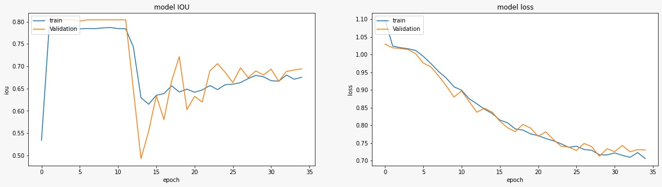
Results Stage-1 Experiment-2

Slide 25
Results Stage-1 Experiment-3

Slide 26
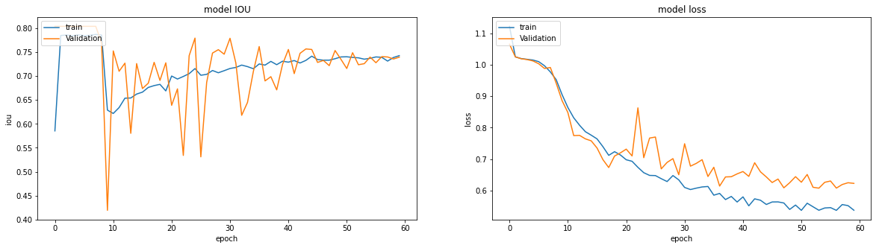
Results Stage-1 Experiment-4

Slide 27
Results Stage-1 Experiment-5

Slide 28
Results
Stage-2 Training IoU Scores
Exp No. | From the Study | From our experiments
Exp3 | 0.7844 | 0.7701
Exp4 | 0.7842 | 0.7724
Exp5 | 0.7850 | 0.7846

Slide 29
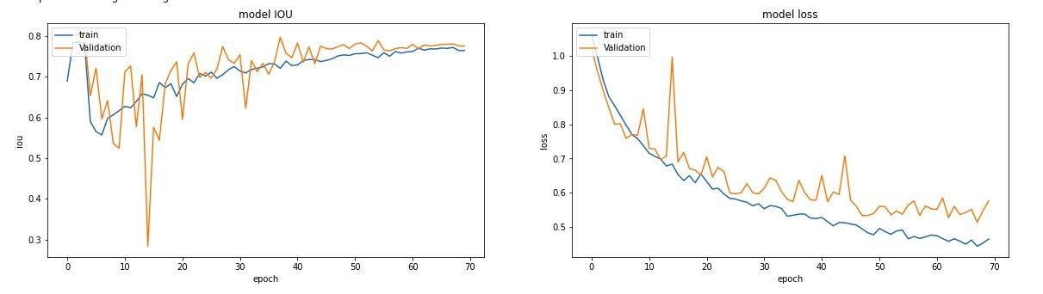
Results Stage-2 Experiment-3

Slide 30
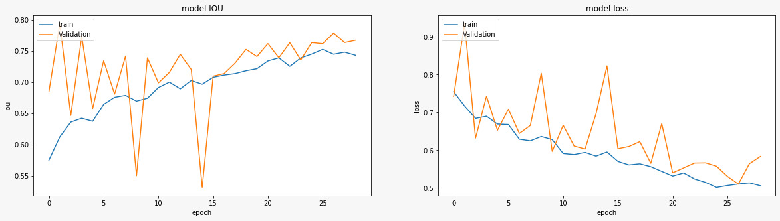
Results Stage-2 Experiment-4

Slide 31
Results Stage-2 Experiment-5

Slide 32
Testing Phase - Scores from experiments
R-TH took values 1024, 2048, 3072, 4096. B-TH took values 0.2 to 0.9 with step size 0.001.
The best results were obtained for R-TH = 3072 and B-TH=0.48. Below listed are the scores obtained for the R-TH and B-TH.
Metric | From the Study | From our experiments | Image-Post Processing
IOU | 0.7850 | 0.7807 | Horizontal Flip & R-TH and B-TH
DSC | 0.8356 | 0.8347 | Only Horizontal Flip.

Slide 33
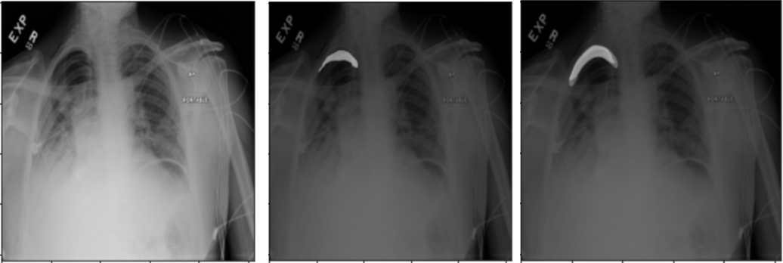
Results- Test phase
Original Ground Truth Predicted

Slide 34
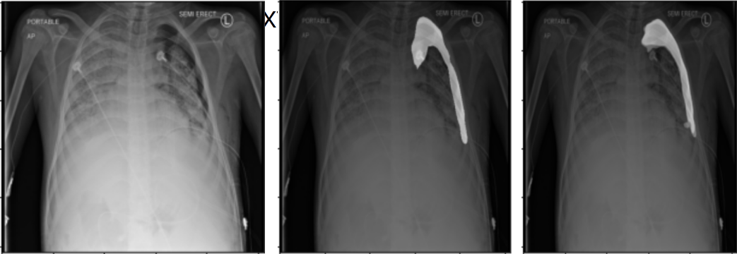
Results- Test phase
Original Ground Truth Predicted

Slide 35
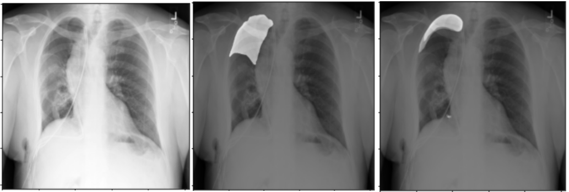
Results- Test phase
Original Ground Truth Predicted

Slide 36
References
The 2-ST UNET for Pneumothorax Segmentation in Chest X-Rays using ResNet34 as a backbone for UNET, Ayat Abedalla, Malak Abdullah, Mahmoud Al-Ayyoub , and Elhadj Benkhelifa, Jordan University of Science and Technology, Irbid, Jordan, September 9, 2020.

Slide 37
Thank You!

